Slide 1









My Number Interactive Workbook
$$×$$
$$\frac{1}{2}$$
$$÷$$
$$+$$
$$−$$
$$\frac{3}{5}$$
$$7$$
Name
Class
Teacher
Term 1 Semester 1
$$5^{2}$$
$$\sqrt{9}$$
1

Slide 2
Create your own front page
It needs to contain the following –
My number interactive notebook
Name
Class
Teachers Name
Semester 1 Term 1
Page number 1

Slide 3
Contents
Glossary or Formula Page
Page
Date
Description
2
3

Slide 4
Tasks
24
7
30
Essential Question
Questions
Notes
Summary
4
5

Slide 5
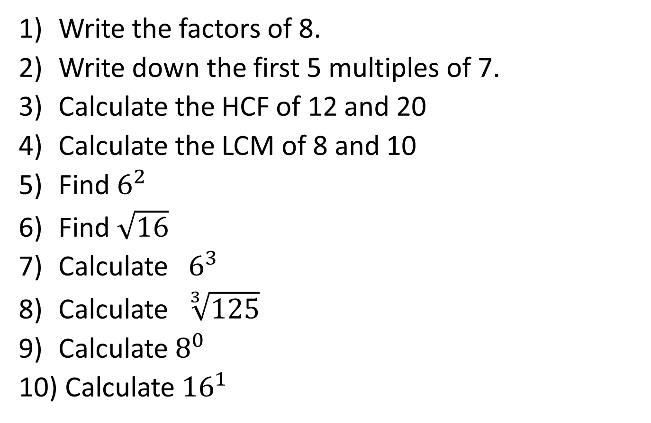
Task One – Show me boards
Write the factors of 8.
Write down the first 5 multiples of 7.
Calculate the HCF of 12 and 20
Calculate the LCM of 8 and 10
Find $6^{2}$
Find $\sqrt{16}$
Calculate $6^{3}$
Calculate $\sqrt[3]{125}$
Calculate $8^{0}$
Calculate ${16}^{1}$

Slide 6
Task Two – Write a definition for the following
Integer
Factor
Multiple
Prime Number
Square Number
Cube Number

Slide 7
24
7
30
Date
Number Properties
EQ – Describe the difference between the HCF and LCM and how both are calculated.
5

Slide 8
24
7
30
Date
Number Properties
EQ – What is the difference between the HCF and LCM and how are both are calculated?
What is an integer?
5

Slide 9
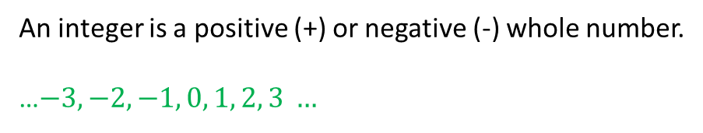
24
7
30
Date
Number Properties
EQ – Describe the difference between the HCF and LCM and how both are calculated.
What is..
an integer?
An integer is a positive (+) or negative (-) whole number.
…$−3, −2, −1, 0, 1, 2, 3 …$
5

Slide 10
24
7
30
Date
Number Properties
EQ – Describe the difference between the HCF and LCM and how both are calculated.
What is..
an integer?
a factor?
An integer is a positive (+) or negative (-) whole number.
…$−3, −2, −1, 0, 1, 2, 3 …$
5

Slide 11
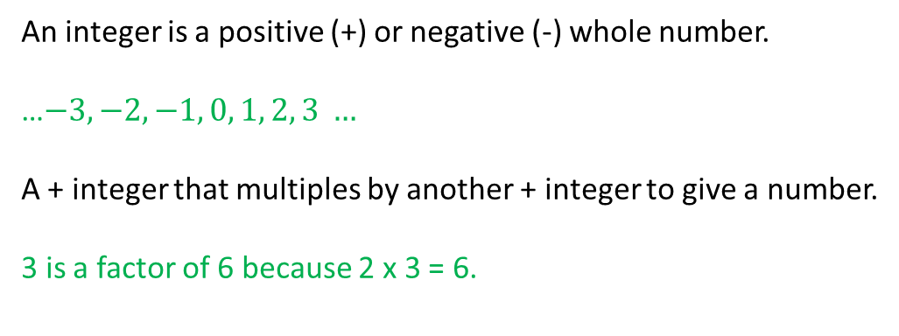
24
7
30
Date
Number Properties
EQ – Describe the difference between the HCF and LCM and how both are calculated.
What is..
an integer?
a factor?
An integer is a positive (+) or negative (-) whole number.
…$−3, −2, −1, 0, 1, 2, 3 …$
A + integer that multiples by another + integer to give a number.
3 is a factor of 6 because 2 x 3 = 6.
5

Slide 12
24
7
30
Date
Number Properties
EQ – Describe the difference between the HCF and LCM and how both are calculated.
What is..
an integer?
a factor?
a multiple?
An integer is a positive (+) or negative (-) whole number.
…$−3, −2, −1, 0, 1, 2, 3 …$
A + integer that multiples by another + integer to give a number.
3 is a factor of 6 because 2 x 3 = 6.
5

Slide 13
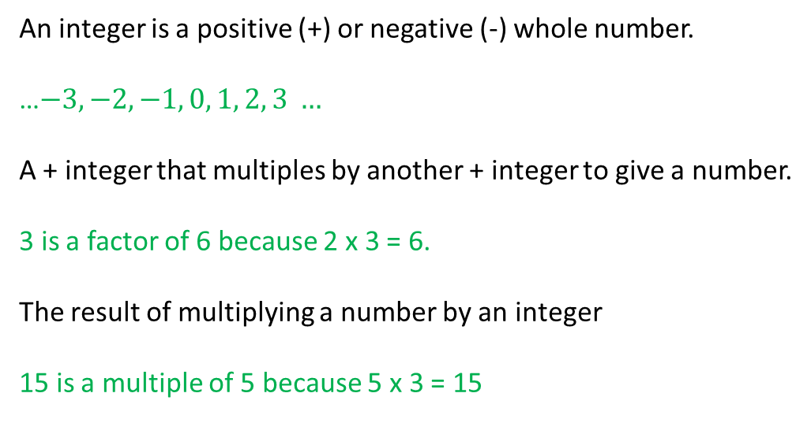
24
7
30
Date
Number Properties
EQ – Describe the difference between the HCF and LCM and how both are calculated.
What is..
an integer?
a factor?
a multiple?
An integer is a positive (+) or negative (-) whole number.
…$−3, −2, −1, 0, 1, 2, 3 …$
A + integer that multiples by another + integer to give a number.
3 is a factor of 6 because 2 x 3 = 6.
The result of multiplying a number by an integer
15 is a multiple of 5 because 5 x 3 = 15
5

Slide 14
24
7
30
Date
Number Properties
EQ – Describe the difference between the HCF and LCM and how both are calculated.
What is..
an integer?
a factor?
a multiple?
a prime number?
An integer is a positive (+) or negative (-) whole number.
…$−3, −2, −1, 0, 1, 2, 3 …$
A + integer that multiples by another + integer to give a number.
3 is a factor of 6 because 2 x 3 = 6.
The result of multiplying a number by an integer
15 is a multiple of 5 because 5 x 3 = 15
5

Slide 15
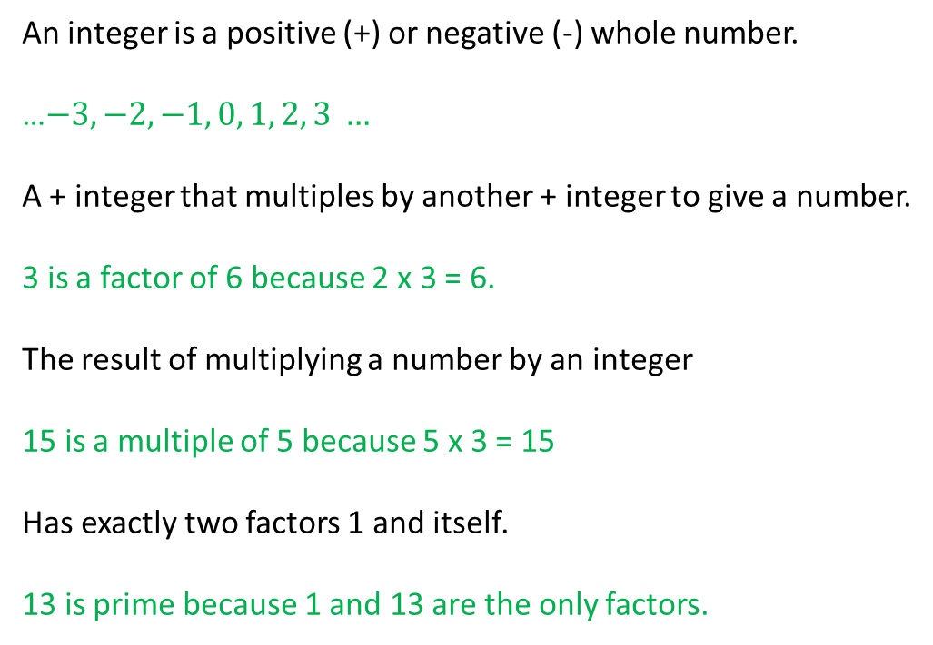
24
7
30
Date
Number Properties
EQ – Describe the difference between the HCF and LCM and how both are calculated.
What is..
an integer?
a factor?
a multiple?
a prime number?
An integer is a positive (+) or negative (-) whole number.
…$−3, −2, −1, 0, 1, 2, 3 …$
A + integer that multiples by another + integer to give a number.
3 is a factor of 6 because 2 x 3 = 6.
The result of multiplying a number by an integer
15 is a multiple of 5 because 5 x 3 = 15
Has exactly two factors 1 and itself.
13 is prime because 1 and 13 are the only factors.
5

Slide 16
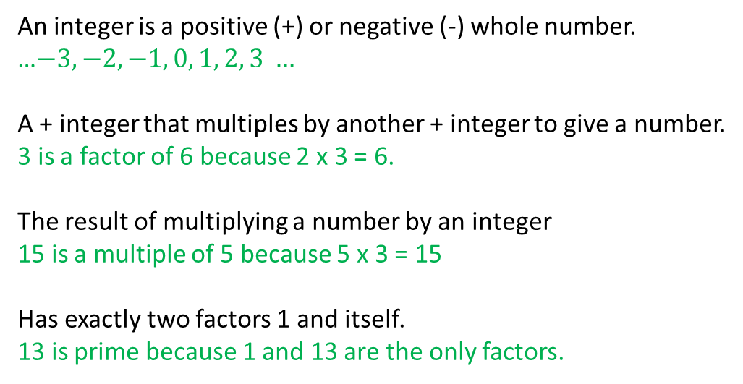
24
7
30
Date
Number Properties
EQ – Describe the difference between the HCF and LCM and how both are calculated.
What is..
an integer?
a factor?
a multiple?
a prime number?
square number?
An integer is a positive (+) or negative (-) whole number.
…$−3, −2, −1, 0, 1, 2, 3 …$
A + integer that multiples by another + integer to give a number.
3 is a factor of 6 because 2 x 3 = 6.
The result of multiplying a number by an integer
15 is a multiple of 5 because 5 x 3 = 15
Has exactly two factors 1 and itself.
13 is prime because 1 and 13 are the only factors.
5

Slide 17
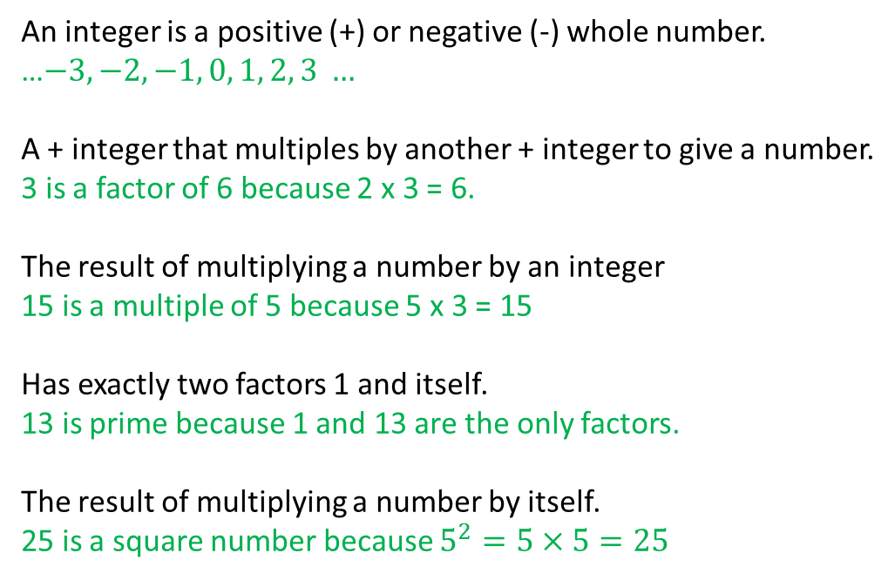
24
7
30
Date
Number Properties
EQ – Describe the difference between the HCF and LCM and how both are calculated.
What is..
an integer?
a factor?
a multiple?
a prime number?
a square number?
An integer is a positive (+) or negative (-) whole number.
…$−3, −2, −1, 0, 1, 2, 3 …$
A + integer that multiples by another + integer to give a number.
3 is a factor of 6 because 2 x 3 = 6.
The result of multiplying a number by an integer
15 is a multiple of 5 because 5 x 3 = 15
Has exactly two factors 1 and itself.
13 is prime because 1 and 13 are the only factors.
The result of multiplying a number by itself.
25 is a square number because $5^{2}=5×5=25$
5

Slide 18
24
7
30
Date
Number Properties
EQ – Describe the difference between the HCF and LCM and how both are calculated.
What is..
an integer?
a factor?
a multiple?
a prime number?
a square number?
a square root?
An integer is a positive (+) or negative (-) whole number.
…$−3, −2, −1, 0, 1, 2, 3 …$
A + integer that multiples by another + integer to give a number.
3 is a factor of 6 because 2 x 3 = 6.
The result of multiplying a number by an integer
15 is a multiple of 5 because 5 x 3 = 15
Has exactly two factors 1 and itself.
13 is prime because 1 and 13 are the only factors.
The result of multiplying a number by itself.
25 is a square number because $5^{2}=5×5=25$
5

Slide 19
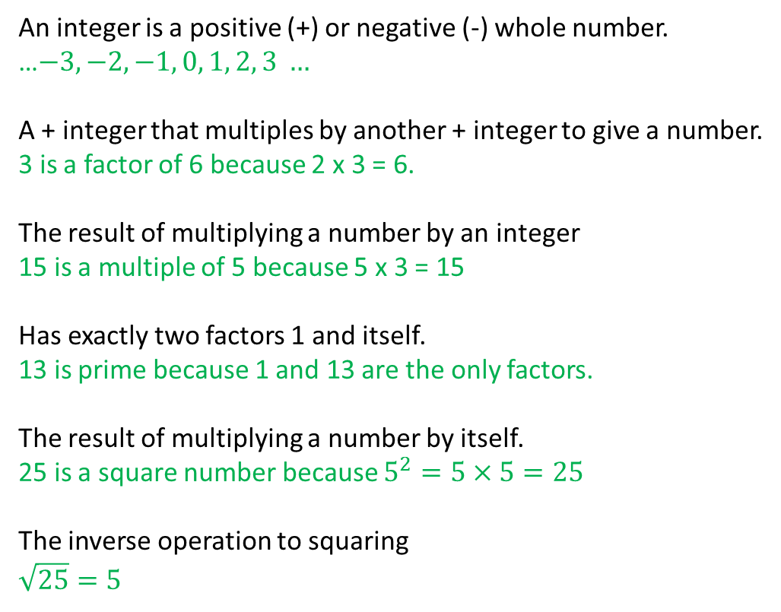
24
7
30
Date
Number Properties
EQ – Describe the difference between the HCF and LCM and how both are calculated.
What is..
an integer?
a factor?
a multiple?
a prime number?
a square number?
a square root?
An integer is a positive (+) or negative (-) whole number.
…$−3, −2, −1, 0, 1, 2, 3 …$
A + integer that multiples by another + integer to give a number.
3 is a factor of 6 because 2 x 3 = 6.
The result of multiplying a number by an integer
15 is a multiple of 5 because 5 x 3 = 15
Has exactly two factors 1 and itself.
13 is prime because 1 and 13 are the only factors.
The result of multiplying a number by itself.
25 is a square number because $5^{2}=5×5=25$
The inverse operation to squaring
$$\sqrt{25}=5$$
5

Slide 20
Notes Review
24, 7 ,30
Date
Title
Essential question
Notes complete
Notes complete with colour and diagrams
Questions completed
Contents page filed in
Formula page filled in

Slide 21
Homework
Review your notes and write a summary answering the essential question.

